Slide 1
AN INTRODUCTION TO POSITIVE BEHAVIOUR SUPPORT (pbs)
Paul Battershall

Slide 2
GROUND RULES
Use respectful terminology
Be honest about your experiences
Be supportive towards each other
Confidentiality

Slide 3
contents
Definition of challenging behaviour
When should we intervene?
Our own challenging behaviour
Functions of challenging behaviour
The escalation cycle
Low arousal approaches
How observant are we?
ABC recording
Positive Behaviour Support (PBS) plans

Slide 4
Definition of challenging behaviour
WHAT IS CHALLENGING BEHAVIOUR?

Slide 5
Definition of challenging behaviour
“Culturally abnormal behaviour(s) of such intensity, frequency or duration that the physical safety of the person or others is likely to be placed in serious jeopardy; or behaviour which is likely to seriously limit use of, or result in the person being denied access to, ordinary community facilities”
(Eric Emerson 1995)

Slide 6
BEFORE WE RESPOND TO A BEHAVIOUR…
We need to ask ourselves:
Is it dangerous behaviour? Is it causing actual direct harm to the individual or others?
Does the behaviour contribute to isolating the person from peers/wider community?

Slide 7
No
Yes
Maybe

Slide 8
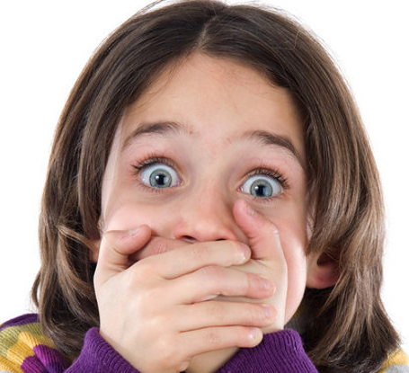
MY
CHALLENGING BEHAVIOUR

Slide 9
IMPORTANT!
Challenging behaviour used to be called ‘problem behaviour’ but it’s important to realise that an individual who displays challenging behaviour is not a ‘problem to be fixed’. Challenging behaviour is a sign that something isn’t working for the individual, and this may be a need that isn’t being met or an inability to communicate their feelings.

Slide 10
So, what factors make a person more likely to become challenging?

Slide 11
What about the functions of behaviour?

Slide 12
Functions of Behaviour
Think SEAT PaD
Sensory or stimulation
Example – Someone enjoys the feeling of blood rushing to their head, so they tie their pyjamas tightly around their neck, causing themselves to become unconscious
Escape/avoidance
Example – Someone does not want to go out to college, so they punch someone, knowing that this will mean that they will be unable to go.
Attention/interaction
Example – Someone is feeling left out in a situation and believes that others are receiving a higher level of attention from staff than they are, so they smash a window, knowing that this will mean that staff will have to intervene.
Tangible reasons
Example – Someone wishes to watch a different TV channel from the one that others are watching, so they persistently slam the lounge door and shout loudly at the others in the room, hoping that this will cause them to leave.

Slide 13
Functions of Behaviour
Think SEAT PaD
Pain and Distress
Example – a service user is in pain and is struggling to or cannot communicate how they are feeling

Slide 14
REMEMBER – If we know why someone behaves in a challenging way, we have a much better chance of preventing the behaviour from happening or preventing it from escalating.

Slide 15
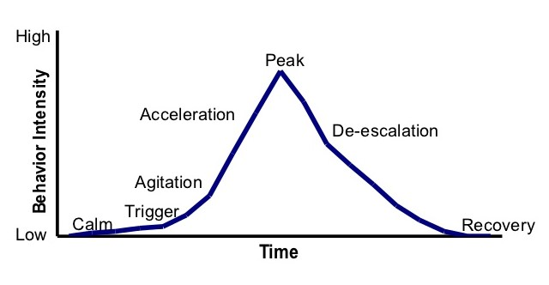
THE ESCALATION CYCLE
Most challenging incidents have several relatively predictable antecedents (things that happened beforehand), and the earlier an intervention occurs the more likely it is to succeed. This process below is known as the Escalation Cycle

Slide 16
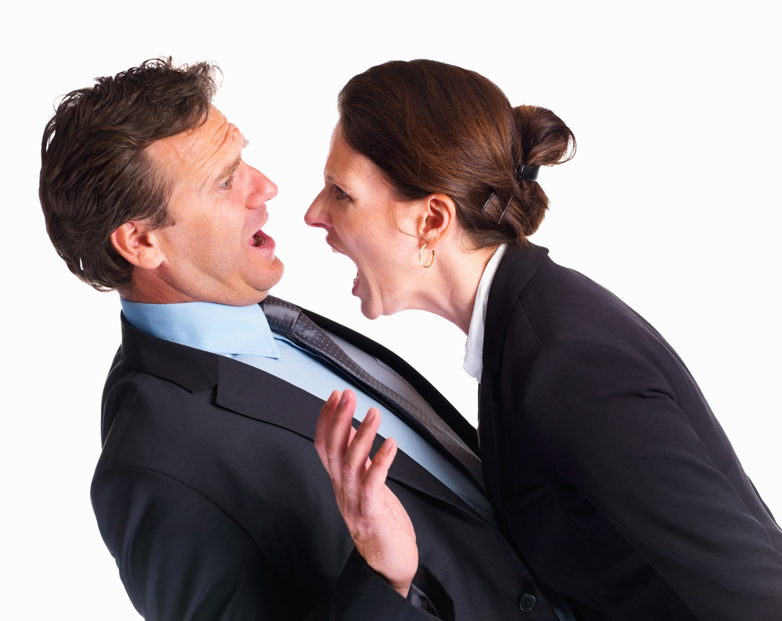
Low
Arousal
Approaches

Slide 17
HOW OBSERVANT ARE WE?

Slide 18
Count the F’s Exercise
Francis was a bit fretful that if she and Fred went to the south of France together for a fortnight to celebrate their fiftieth wedding anniversary, her elderly father might forget to feed their dog and four cats for them. Of course, if that happened, Fred would be really angry (and so would the five pets).
C/Documents/Count the F’s exercise

Slide 19
Blank Space
(so you can’t cheat)

Slide 20
Count the F’s Exercise
Francis was a bit fretful that if she and Fred went to the south of France together for a fortnight to celebrate their fiftieth wedding anniversary, her elderly father might forget to feed their dog and four cats for them. Of course, if that happened, Fred would be really angry (and so would the five pets).
(20)
C/Documents/Count the F’s exercise

Slide 21
ABC CHARTS
ABC charts are a good way of tracking and recording a behaviour and understanding what happened in the run up to it, during and after as a way to recognise any patterns
Antecedent – what happened right before the behaviour, what was the trigger
Behaviour – what the behaviour looked like
Consequence – what happened after as a result of the behaviour

Slide 22
Positive Behaviour Support (PBS)
The overarching aim of PBS is to improve the quality of a person’s life and that of the people around them.
Key Principles
Person-centred approach, ensuring the individual is always at the centre of things
Is supportive and respectful, and focuses on understanding the purpose that the behaviour of concern is serving for the person within their environment
Positive – looks at being proactive and preventative rather than reactive
Aims to teach new skills to replace behaviours that challenge

Slide 23
Positive Behaviour Support (PBS)
Describe the behaviour/s that might be displayed
What are the difficult situations? (Triggers)
What are the early warning signs? (Cues)
Proactive Strategies How might we prevent the behaviour from happening? Think about the personal and environmental factors in the ‘Triggers’ section.
Active Strategies What should we do or say at the first signs of the behaviour to stop the situation from escalating further? i.e. when we see the things in the “Cues” section
Reactive Strategies How should we respond if the behaviour occurs? What things can we quickly do or say to quickly manage the situation and to prevent unnecessary distress, injury or destruction?

Slide 24
Positive Behaviour Support (PBS)
Post Incident Support What things can we do or say to support the person to become calm again after an incident?

