Slide 1
HOW TO MANAGE POOR PERFORMANCE

Slide 2
GROUND RULES for session
Join in the conversation
Use respectful terminology
Be honest about your experiences
Be supportive towards each other
Confidentiality

Slide 3
QUESTION…
What types of poor performance or behaviour issues have you come across at work?

Slide 4
PERFORMANCE MANAGEMENT GENERAL PRINCIPLES
Identify the issue/s
Establishing the actual performance issue/s is the first thing to do to successfully manage poor performance within a team.
Act now, not later
If you’re having concerns about a particular employee, it’s important to make sure you express these to the person as soon as possible. The longer you allow a behaviour to continue, the more difficult it becomes to tackle.
Be consistent and fair
You MUST be consistent and fair in your response to poor performance and not react differently to different staff.

Slide 5
PERFORMANCE MANAGEMENT GENERAL PRINCIPLES
Privacy
Tackling someone about their performance in public is both disrespectful and an abuse of power. ALWAYS find a private place to discuss your concerns.
Don’t attack them
Voice your concerns in a calm and constructive manner. Bear in mind the person might have personal matters going on in the background.
Document
Always record any intervention you have with a staff member about their performance.

Slide 6
BE CAREFUL
Don’t ‘pass the buck’
Don’t make a joke of it
Don’t talk about other things at the meeting

Slide 7
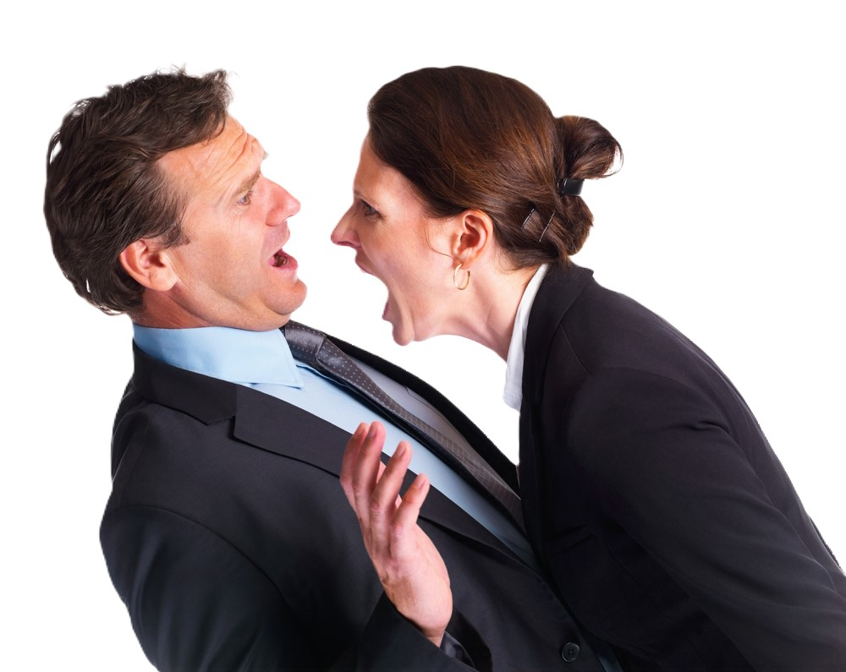
Deciding what type of intervention is required
In some situations, immediate intervention is required
Explain you need to speak to the person
Find a private place to talk
Be specific about the issue/s
Ask questions – what are their explanations for the poor performance
Explain why we do things a certain way (risk, respect, consistency etc.)
Explain the impact of their behaviour on other people or on JRH Support
Explain what is expected of them going forwards (outcome)
Document as a ‘Performance issues’ event on People Planner

Slide 8
Deciding what type of intervention is required
Planned informal private meeting
Prepare for the meeting
Identify a mutually appropriate time and place to meet
If possible, have information to present (witness statements, screenshots, observations etc.)
Be specific about the issue/s
Ask questions – what are their explanations for the poor performance
Explain why we do things a certain way (risk, respect, consistency etc.)
Explain the impact of their behaviour on other people or on JRH Support
Explain what is expected of them going forwards (outcome)
Document as a ‘Performance issues’ event on People Planner

Slide 9
Deciding what type of intervention is required
Formal private meeting – Coaching & Development Meeting
These meetings are for ‘repeat offenders’ or for more serious situations that are not quite serious enough to warrant disciplinary action.
Prepare for the meeting – complete some of the form
If possible, have information to present (witness statements, screenshots, observations etc.)
Identify a mutually appropriate time and place to meet
Follow the form questions
Document as a ‘Coaching & Development Meeting’ event on People Planner

Slide 10
Thinking back to the poor performance or behaviour issues you came up with earlier….
How would you manage them now?

