Slide 1
Emergency First Aid at Work

Slide 2
Contents
Roles and responsibilities of a first aider
Dealing with an unresponsive casualty
Choking
Shock
Seizures
Heart attacks
Strokes
Diabetes
Head injuries
Minor burns and scolds
Minor cuts and grazes
Poisons
Asthma

Slide 3
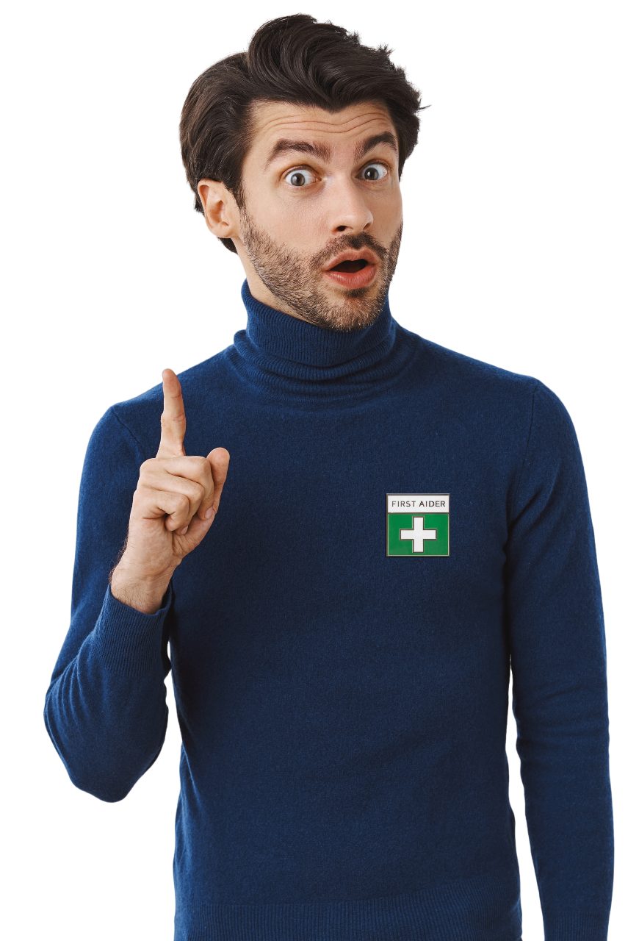
The role of the first aider
Preserve Life
Administer immediate effective first aid to a casualty in order to safe life.
Prevent the Condition from Worsening
Recognising and treating the cause will assist with preventing the condition from worsening.
Promote Recovery
Administer ongoing treatment and offer constant support until the arrival of qualified medical assistance.

Slide 4
The responsibilities of the first aider
Ensure first aid equipment is fit for purpose.
Ensure the scene is safe.
Contact emergency services.
Prioritise the treatment of casualties.
Clear up after an incident.
Incident reporting and recording.

Slide 5
Dealing with an unresponsive casualty
*Practical
1. Check for danger
Your first step of action is to assess the situation. Checking for dangers to yourself and the casualty is vitally important.
These potential dangers can come from your surrounding environment, such as traffic, water, animals or electricity, or even bystanders.

Slide 6
Dealing with an unresponsive casualty
*Practical
2. Check for a response
A response can usually be quickly established by talking to the casualty or by gently shaking their shoulders.
If a casualty is semi-conscious, they may not be able to verbally respond to you but they may still be able to hear you, so remain as calm as possible whilst letting them know who you are, and that you are there to help.

Slide 7
Dealing with an unresponsive casualty
*Practical
3. Open the airway
It’s important to check that the airway of the casualty is clear. You can do this by placing one hand on the forehead and two fingers under the chin, gently tilting their head backwards. As you do this, the mouth will fall open slightly.

Slide 8
Dealing with an unresponsive casualty
*Practical
4. Check for breathing
Place your ear next to the casualty’s mouth with your face towards their chest. Look, listen and feel for normal breathing.
If there are any foreign objects blocking the airway inside the mouth, they will need to be removed (wearing disposable gloves).

Slide 9
Dealing with an unresponsive casualty
*Practical
5. Circulation
If the casualty is not breathing you should call 999 immediately.
Until help arrives, chest compressions and rescue breathing should be administered.
After completing a set of 30 chest compressions, 2 effective rescue breaths should be administered.

Slide 10
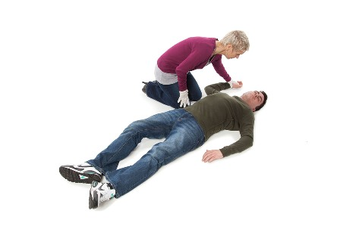
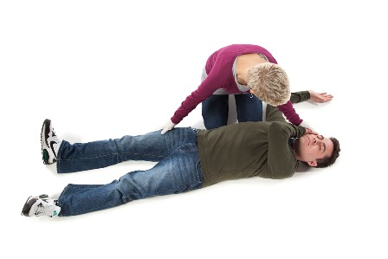
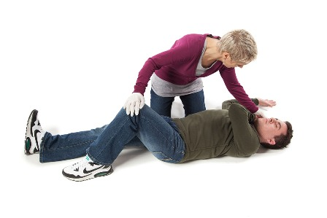
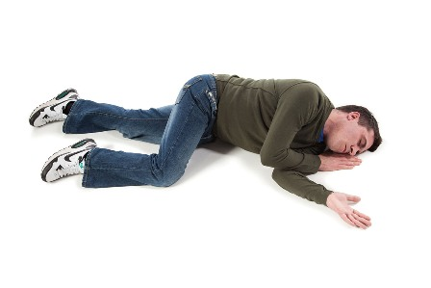
*Practical Recovery Position
Recovery Position
1.
2.
3.
4.

Slide 11
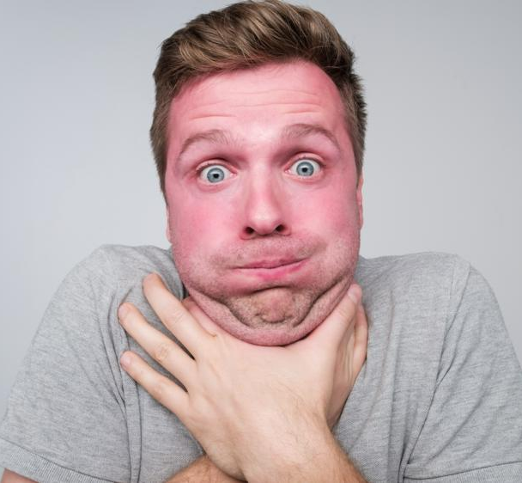
What do you think is happening to this person?

Slide 12
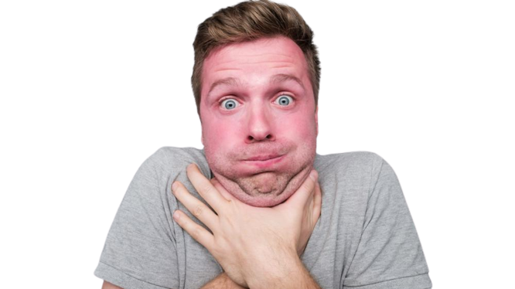
Recognising a choking casualty
Grasping at the throat area.
Difficulty in breathing and speaking.
Redness of the face.
Eyes enlarged and watering.
Displaying distress.

Slide 13
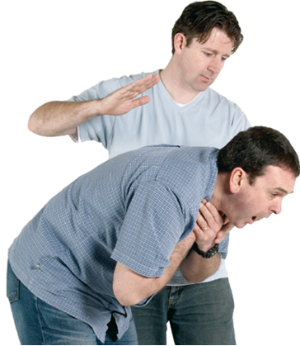
*Practical Back Blows
Back blows
Lean the casualty forward (supporting the upper chest with one hand).
Administer a maximum of 5 sharp back blows with the other hand.
If after 5 sharp back blows the obstruction still remains, then administer abdominal thrusts.

Slide 14
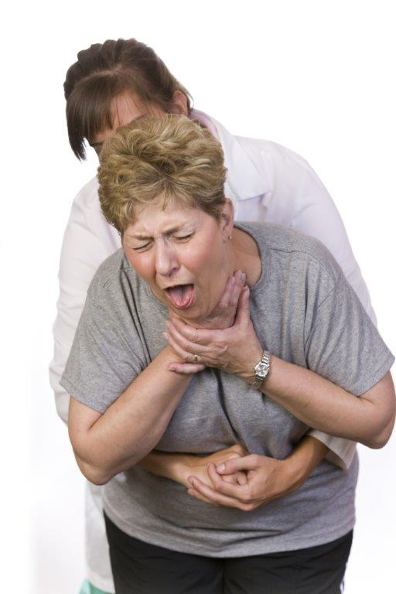
*Practical Abdominal Thrusts
Abdominal thrusts
Stand behind the casualty, lean them forward and place your hands around their stomach.
Make a clenched fist with one hand and place the thumb of the clenched fist above the navel.
Cup the clenched fist with the other hand and pull inwards and upwards in one motion.
Repeat this procedure up to a maximum of 5 times
If still choking after this, contact emergency services.

Slide 15
Shock
Physiological shock (circulatory shock)
Shock is a life-threatening condition that occurs when the body’s vital organs such as the heart and brain are deprived of oxygen due to a problem that affects the circulatory system.
RECOGNITION
A visible associated wound
Pale, blue/grey, cold clammy skin
Rapid weak pulse
Rapid shallow breathing
Nausea and thirst
TREATMENT
Treat the cause if apparent.
Lay the casualty down on a flat surface and raise the legs, ensuring the legs are above the level of the heart.
Loosen tight clothing.
Keep the casualty warm with a blanket.
Monitor the casualty’s airway and breathing.
Do not allow them to have food or drink (could vomit).
Contact emergency services 999

Slide 16
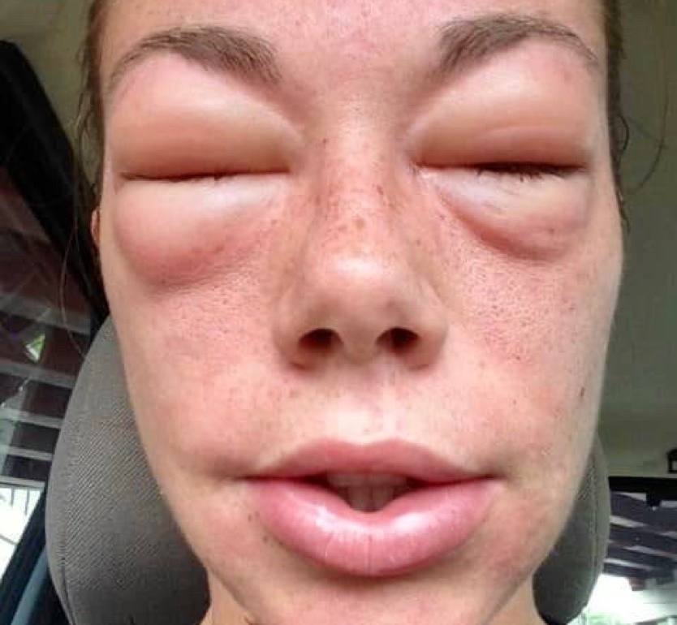
What do you think is happening to this person?

Slide 17
*Practical EpiPen
Anaphylaxis
Anaphylaxis is an extreme and potentially life-threatening allergic reaction, which results in rapid changes in the body. Anaphylaxis can be caused by a ‘trigger’ such as insect stings, foods (e.g. nuts or shellfish) and medicines such as penicillin.
RECOGNITION
Swelling of the mouth
Difficulty in breathing
Red, blotchy and itchy skin
Nausea
Anxiety
TREATMENT
Contact the emergency services 999
Encourage the casualty to use their medication if applicable (antihistamine or auto injector)
Sit the casualty down
Remove the trigger if possible
Monitor the casualty (airway and breathing)
Be prepared to carry out basic life support

Slide 18
Seizures
Generalised seizures
An epileptic seizure is caused by a sudden burst of electrical activity in the brain, causing a temporary disruption to signals between brain cells. Generalised seizures may cause the casualty to lose consciousness and experience muscle spasms.
RECOGNITION
Convulsions
Shallow breathing
Blue/purple colouration of the skin (cyanosis)
Confusion and fatigue
Rigidity
Crying out
Muscle jerks
TREATMENT
Remove dangerous items from the vicinity if possible
Remove any spectacles and loosen clothing around neck
Put padding beneath their head but DON’T restrain them
Record the time and duration of the seizure
If the seizure continues, there are multiple seizures, or this is the person’s first seizure, call 999
When seizure stops clear any saliva and check airways and breathing
Place in recovery position and reassure

Slide 19
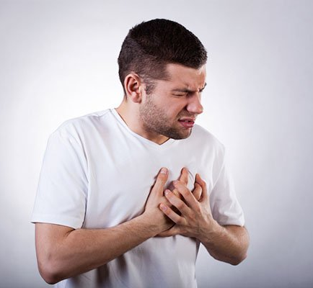
What do you think is happening to this person?

Slide 20
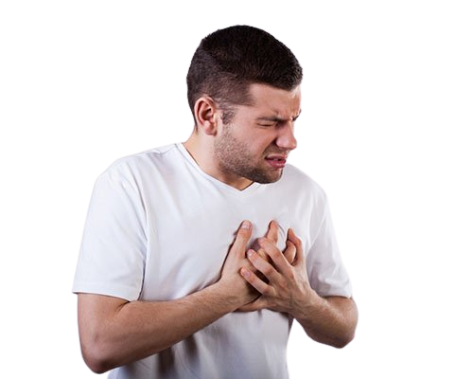
Heart attack
A heart attack occurs when the coronary arteries, which supply the heart with oxygen enriched blood, become blocked.
RECOGNITION
Tightness and/or pain in the chest (mild or severe)
The casualty might be clutching their chest
Possible spreading of pain to arms, neck and back
Dizziness or light-headed feeling
Possible shortness of breath
Feeling nauseous and cold sweats

Slide 21
Heart attack
TREATMENT
Call 999 immediately.
Sit the casualty down with their legs drawn up or in a position which is comfortable.
Loosen any restrictive clothing.
Keep the casualty warm and comfortable.
Monitor the casualty’s airway and breathing.
If they become unresponsive, carry out basic life support (CPR)

Slide 22
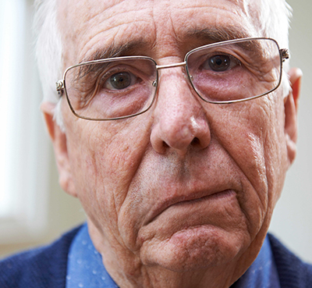
What do you think is happening to this person?

Slide 23
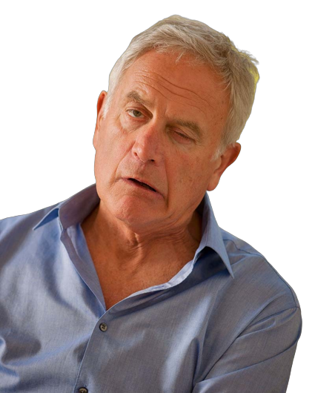
Stroke
A stroke is either short-term or permanent damage to the brain and/or body. If you suspect a stroke then you must act FAST.
Facial weakness
Can the person smile?
Has the face dropped on one side?
F
A
Arm weakness
Can the person raise both arms?
S
Speech problems
Can the person speak clearly and understand what you say?
T
Time to call 999
By calling 999 early, treatment can be given which can prevent further damage.

Slide 24
Stroke
TREATMENT
Call 999 immediately.
If responsive lay the casualty down with the head and shoulders raised, or assist into a comfortable position.
If unconscious place into the recovery position.
Loosen any restrictive clothing.
Wipe any saliva away.
Monitor airway and breathing
If they become unresponsive, carry out basic life support (CPR)

Slide 25
Diabetes – Hypo & Hyper
Hypoglycaemia Blood sugar level low
Hypoglycaemia
RECOGNITION
Blurred vision
Hunger
Tiredness or lethargy
Lack of concentration
Increased heart rate
Headaches
Tingling sensations
Changes in personality
Feeling faint
Hypoglycaemia
TREATMENT
Sit the casualty down, calm and reassure
Give a sugary drink or sugary food (e.g. glucose sweet)
If the condition improves offer further sugary drinks or foods
If there is no improvement in the casualty’s condition then call 999
Monitor the condition. If the casualty becomes unconscious carry out basic life support

Slide 26
Diabetes – Hypo & Hyper
Hyperglycaemia
Blood sugar level high
Hyperglycaemia
RECOGNITION
Sweet, fruity-smelling breath
Increased need to urinate
Increased thirst
Dry mouth
Loss of appetite
Tiredness and lethargy
Hyperglycaemia
TREATMENT
Sit the casualty down, calm and reassure
Encourage the casualty to use their medication
If they have not previously been diagnosed then call 999
Monitor the condition. If the casualty becomes unconscious carry out basic life support

Slide 27
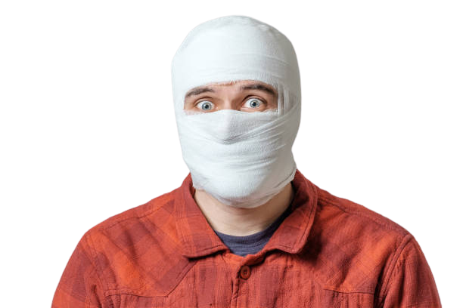
Head injuries
IMPORTANT - All head injuries have the potential to be life-threatening, and qualified medical assistance should be sought in all instances where a major head injury is suspected.
Types of head injuries include concussion, cerebral compression and skull fracture.

Slide 28
CONCUSSION
What is it?
Shaking of the brain causes temporary disturbance of normal brain activity. Often caused by a blow to the head.
CEREBRAL COMPRESSION
What is it?
A build-up of pressure on the brain caused by brain tissue swelling or an accumulation of blood.
SKULL FRACTURE
What is it?
Can be either open or closed; caused by either a direct or indirect blow to the head.
RECOGNITION
RECOGNITION
RECOGNITION
Possible brief loss of consciousness
Dizziness and nausea
Headache
Brief loss of memory
Blurred vision
Intense headache
Drowsiness
Unequal pupil sizes
Slow, strong pulse
Weakness or paralysis down one side of the body
Noisy breathing
Associated wound
Tenderness and pain
Depression/deformity of the skull
Bruising and swelling at the site of injury
Presence of cerebral spinal fluid (CSF) from ears and nose

Slide 29
Head injuries
TREATMENT (General)
Control any bleeding and/or CSF loss
Contact emergency services – 999
Place the casualty in a comfortable position, preferably on a flat surface with the head and shoulders raised
Monitor the casualty and be prepared to carry out basic life support

Slide 30
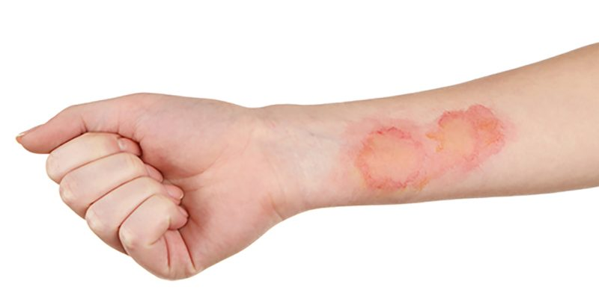
Minor burns and scalds
A burn or scald injury can be caused by many things such as:
Radiation (sunlight, sunbeds, X-rays)
Direct heat (fire, iron, kettle, cooker, machinery)
Electricity, domestic supply appliances (high and low voltage)
Extreme cold (freezing temperatures, frozen objects)
Chemicals (domestic, industrial)
Inhalation of toxic fumes (from a fire)
Scalds (hot liquids, fats, steam)

Slide 31
Minor burns and scolds
RECOGNITION
Pain at the site of the injury
Redness, tenderness and swelling
Possible blistering
TREATMENT
Remove the source of the burn if possible
Wear disposable gloves
Flush the area of the wound with tepid water for a minimum of 10 – 20 minutes
Remove any restrictive clothing or jewellery as swelling may occur
Do not remove anything that is stuck to the burnt skin
Seek medical attention immediately
For electrical burns make sure the source has been disconnected

Slide 32
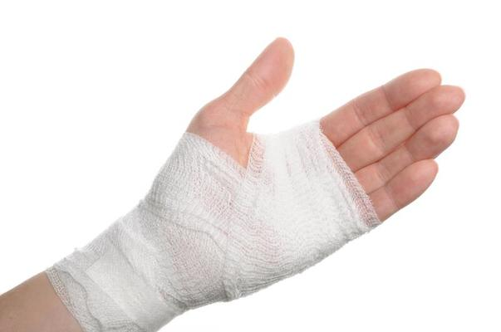
*Practical Applying a Dressing
Minor cuts and grazes
MINOR CUTS
Minor cuts may hardly bleed at all. However, they can be painful for the casualty.
GRAZES
The top layer of skin (epidermis) is rubbed away and the nerve endings are exposed. Capillary bleeding may occur at the site of the graze and blood will ooze from the wound.
Look at the wound for any foreign embedded objects
Wear disposable gloves
Clean the affected area with a sterile cleansing wipe
If required, apply direct pressure to the wound
Apply a dry, sterile dressing to the wound

Slide 33
Poisons
A poison can be defined as a foreign substance that enters the body by means of ingestion, inhalation, absorption or injection which, in sufficient quantity, interferes with the normal body functions.
RECOGNITION
Pains in the stomach
Impaired vision
Increased/decreased heart rate
Smell of fumes or chemicals
Burns and rashes
Nausea and vomiting
Difficulty in breathing
TREATMENT (General)
Dial 999
Ensure the scene is safe
Remove the cause or remove the casualty from the scene
Be prepared to carry out basic life support
DO NOT encourage vomiting or moving around

Slide 34
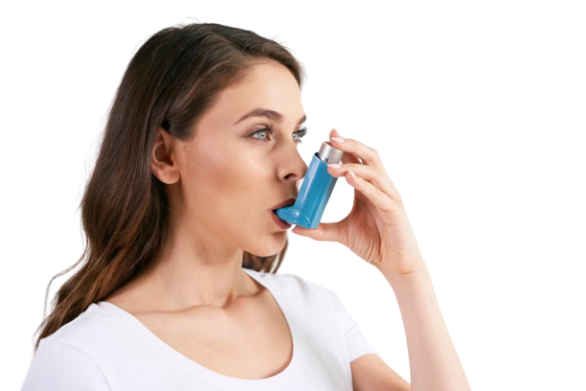
Asthma
RECOGNITION
Tightness and/or pain in the chest (mild or severe)
The casualty might be clutching their chest
Possible spreading of pain to arms, neck and back
Dizziness or light-headed feeling
Possible shortness of breath
Feeling nauseous and cold sweats
Asthma is a condition that affects and inflames the airways, making it difficult to manage normal breathing.
TREATMENT (General)
Assist the person to sit down
Reassure the person
Ensure medication (inhaler) is used
If attack is prolonged, contact emergency services
Be prepared to carry out basic life support

