Slide 1
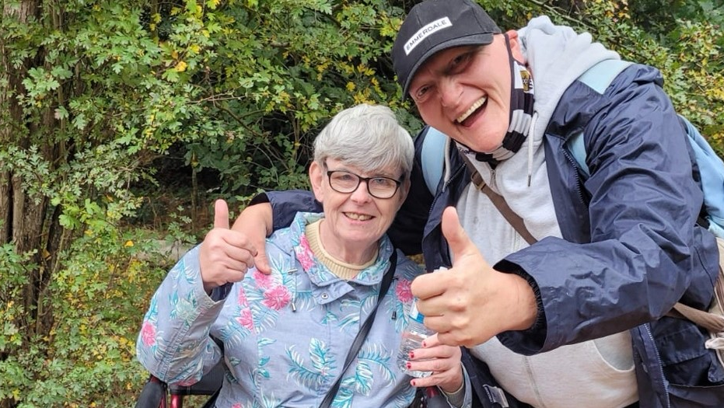
Working with
Outcomes

Slide 2
What are they?
They explore a service user’s hopes for the future and create a plan for how these can be achieved
They help us to work with the service user to identify, measure and support the positive changes needed to achieve their hopes and ambitions

Slide 3
Why have them?
They focus on what matters to the person
They identify and build on the person’s strengths
They empower the person
We are contracted by the council to use an outcomes approach

Slide 4
Outcomes should be:
Person-centred
Achievable
Measurable

Slide 5
“I want to be able to take my medication without the need for any support”

Slide 6
The Outcomes Process:
What I would like to achieve
Where I am/what I have already achieved
What success looks like
What are the next steps

Slide 7
Before review
OUTCOMES - Medication
Outcome number | What I would like to achieve | What I have already achieved (where I am) | Present score | What does success look like? | What I am working on at the moment
1 | I want to be able to take my medication without the need for any support | a) My medication is kept in the office and every morning a staff member gets my tablets out of the box whilst I get a glass of water, and then I take my tablets b) I have the NHS app on my mobile and every 2 months my support worker supports me to login and then I observe them ordering my repeat prescription | 2 | Taking the right medication every day on my own. Ordering a repeat prescription every 2 months without support. | a) I keep my medication in my bedroom and every morning a staff member talks me through getting my 2 tablets out of the boxes and taking them. b) I have the NHS app on my mobile and my keyworker reminds me every 2 months that I need to order a repeat prescription and talks me through doing this on the app.
This is what has already been achieved
This is what is currently being worked on and should be described in detail in the support plan

Slide 8
Review
OUTCOMES - Medication
Outcome number | What I would like to achieve | Where I am with this at the moment/achieved | Present score | What does success look like? | What I am working on at the moment
1 | I want to be able to take my medication without the need for any support | a) I keep my medication in my bedroom and every morning a staff member talks me through getting my 2 tablets out of the boxes and taking them. b) I have the NHS app on my mobile and my keyworker reminds me every 2 months that I need to order a repeat prescription and talks me through doing this on the app. | 3 | Taking the right medication every day on my own. Ordering a repeat prescription every 2 months without support. | a) I will get the right tablets out of the boxes whilst a support worker observes me a) I will talk through what I am doing as I prepare and take my medication and the support worker will verbally prompt me if I get mixed up
This is what has already been achieved
This is what is currently being worked on and should be described in detail in the support plan

Slide 9
Review
OUTCOMES – Medication
Outcome number | What I would like to achieve | Where I am with this at the moment/achieved | Present score | What does success look like? | What I am working on at the moment
1 | I want to be able to take my medication without the need for any support | a) I keep my medication in my bedroom and every morning a staff member talks me through getting my 2 tablets out of the boxes and taking them. b) I have the NHS app on my mobile and my keyworker reminds me every 2 months that I need to order a repeat prescription and talks me through doing this on the app. | 3 | Taking the right medication every day on my own. Ordering a repeat prescription every 2 months without support. | a) I will get the right tablets out of the boxes whilst a support worker observes me a) I will talk through what I am doing as I prepare and take my medication and the support worker will verbally prompt me if I get mixed up b) ?
What could be the ‘next steps’ for the repeat prescription?

